Slide 1


CMP309 – Software Development for mobile devices
Ethan Hastie
Student ID:1801853
Project Title: To-Do App
Notes:
Hello and welcome to my presentation for my Android project that I implemented as part of my Android module CMP309 Software Development for Mobile Devices.
My name is Ethan Hastie, Student ID 1801853 and the title of my project is called ‘To-Do App’.

Slide 2
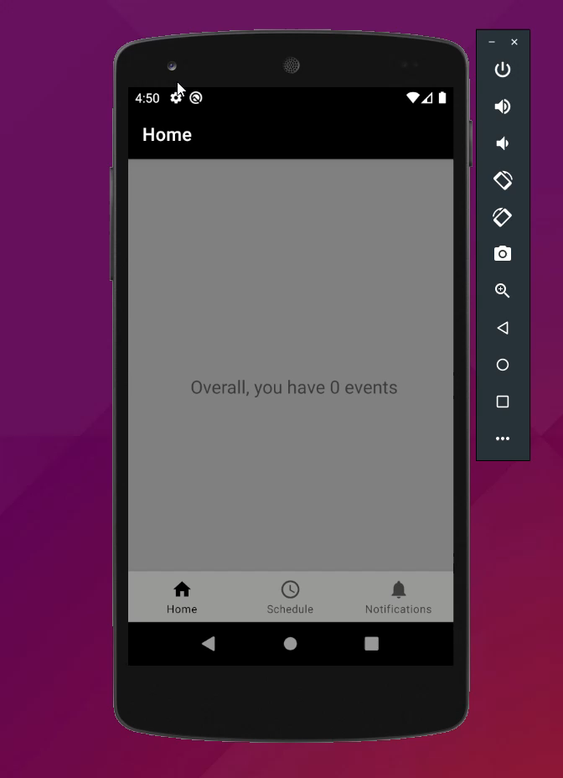
App DemonStration
Notes:
I will now show you a short demonstration of my app which was performed on a Nexus 5 API 29 emulator.

Slide 3
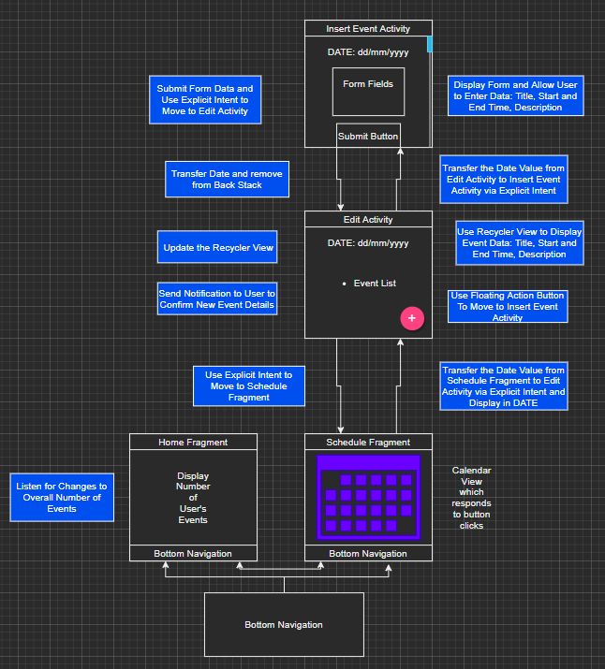
Notes:
As you can see here this is my diagram that showcases the elements of my app. The app uses a bottom navigation and can move between two fragments.
The home fragment displays the overall number of user events and the schedule fragment displays a calendar view. When a date is clicked this moves to another activity showing the users events for that day.
If the user wants to make another event this will move to another activity with a form in it to allow the user to enter their data via a button.
Then, when the user has submitted the data, this will move back to the edit activity showing their new event. To ensure correct navigation, the user cannot move back to the form due to the back stack.
Once they move back to the schedule fragment, they can see the change in the home fragment as the overall number of events has increased.

Slide 4
Code - Overview
Notes:
So, in these next few slides, I will discuss specific coding elements within my application. Some of these are key features required by the application and others are less necessary but are still interesting to discuss.

Slide 5
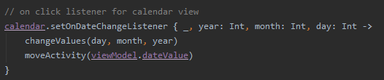
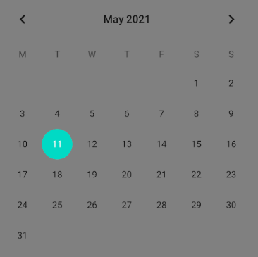
Notes:
One of the most important functionality I implemented was a calendar view. The on click listener grabs the day, month and year value of whatever the user clicked and passes this via an explicit intent to an edit activity, showing the users events for that day.

Slide 6
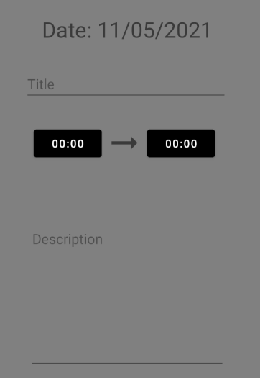
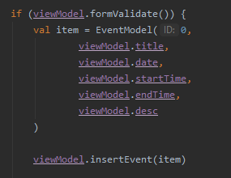
Notes:
I also have a form that accepts data from the user to enter into the database. Form validation is in place to make sure that the user does not leave any fields empty.

Slide 7
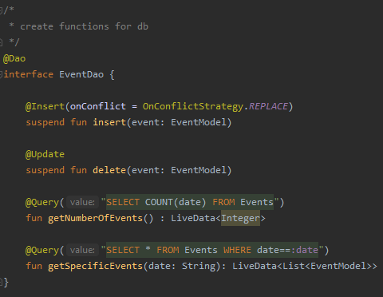
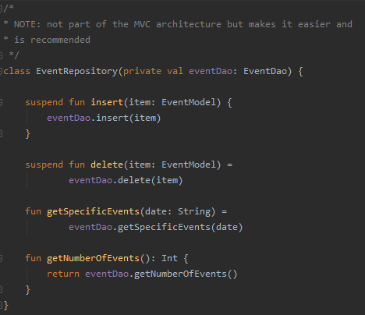
Notes:
Here, you can see on the left my DAO interface class that I can use to do entries in my database.
The event repository class on the right is not part of the MVC architecture pattern but it helped me access the DAO much easier.

Slide 8
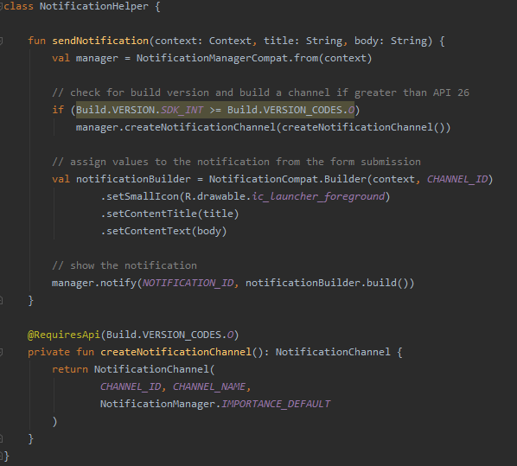
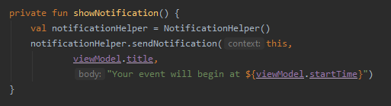
Notes:
This is the code that I used to build the notification feature within my app. Every time a user submits an entry in the database, a notification appears with their data such as the title of their event and what time their event starts and ends at, acting as a confirmation of their form submission.

Slide 9
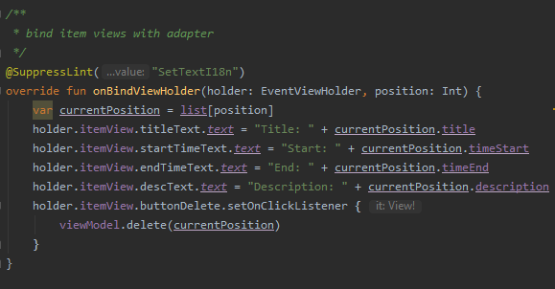
Notes:
The adapter I implemented as part of my edit activity binds the items held in list. This is used within the edit activity to display the users events for that date.

Slide 10
Overview - CritiCal Analysis
Features
Usability
Performance
Security
Notes:
In these next few slides I will evaluate my mobile app in terms of the features I implemented, the usability of my app, how I considered the performance of my app and how my app deals with security issues such as app permissions and user data.
In these sections, I will discuss some limitations of my app features and evaluate how I could have done things better.

Slide 11
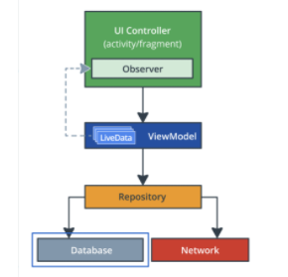
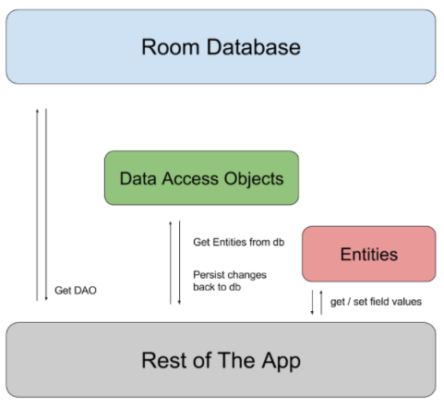
features
Database
SQLite
Room
Firebase Firestore
Notes:
In this slide I will discuss the features I implemented in my project.
The database feature was one of the most necessary requirements for my app. This would allow for the saving of data in a database in an efficient manner. Originally, I was going use SQLite as part of my database requirement but I soon realised that this would take a lot of time to configure and is not very efficient to code with. The Room persistence library was a much more efficient option that works on top of SQLite and still fulfils the requirements. Compared to SQLite, Room is much easier to setup and configure. The utility of being able to setup a DAO interface meant that queries could be configured easier and SQL queries could be mapped to functions inside Kotlin, meaning queries did not need to be repeated over multiple files.
Firebase Firestore would also have been another alternative option I could have utitlised in my application but I ultimately did not decide to go with this. With Room, data can be accessed offline which would help benefit users who are not connected to the internet.

Slide 12

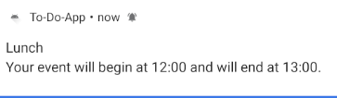
features
Notifications
When the user submits an event
Notes:
The notification feature I implemented was originally going to alert users to their next event which would have provided excellent synergy with my database feature.
This would have allowed users to be reminded of events in their schedule but due to time constraints I had to think of another method of incorporating the notification API into my app.
Instead, whenever a user submits an event this will generate a push notification to the users phone showing information about their event. This could have been better implemented as it uses a button function. It is still usable but less effective.

Slide 13
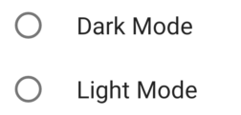
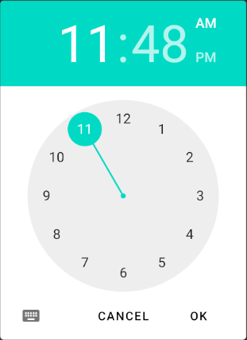
Usability
Dark Mode/Light Mode options
Time Picker Dialog
Notes:
In this slide I will discuss usability.
I think my User Interface could have been improved. The UI in my app could have benefited from a dark mode and light mode feature. This would have made sure that users are able to view my app however they wish. The dark mode feature would have meant that the app would have cared more towards the saving of battery life which would have benefited the app. However, I chose to focus on the main features of my app and the use of a database was more important than using shared preferences. This could perhaps be an area for future work.
When users are able to create events, I was struggling to figure out how users would be able to enter dates into the form. This is where I came across Time Picker dialogs which you can see here. I initially implemented this thinking it would be efficient for users to select start and end times for events, but as I was going through the app I realised that the button listeners for this feature were too inefficient and the UI design for the time picker could be improved.

Slide 14
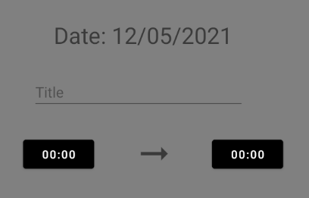
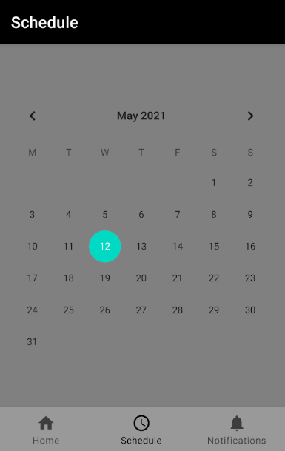
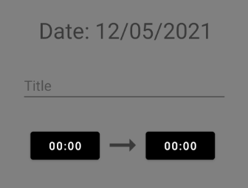
Usability
Use of Colours
Orientation
Notes:
My UI could also have been improved upon was through my colour scheme. This also links back to what I was discussing earlier about dark/light mode options. The colour scheme in this app could be improved and was very basic. I think more time could have been taken to ensure that the colours represented in this app were clear and should have taken more time. As you can see here, the calendar view had a default colour of cyan which I was hoping to change to another colour. I was unhappy about this because it also doesn’t match the overall tone of the app.
I also think orientation could have been handled better in some aspects of my app. One example of this was in the form I setup. The visual presentation in portrait, which you can see in the bottom right, is much better compared to landscape, seen in top right. The landscape version has some glitches compared to the portrait. I do think the inclusion of the scroll view on this activity benefited this screen a lot, although I still think it could have been improved greatly. The one factor I am happy about for orientation is that the use of the MVC architecture means that data is not lost through orientation changes.

Slide 15
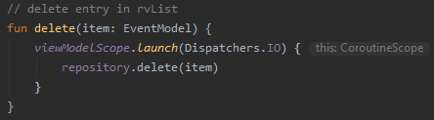
Performance
Dark / Light Mode
Room Database
Use of Coroutines
Notes:
In this slide I will discuss how I considered performance in my project.
The app performs functionally and does what it was designed to do, although some issues are present. The main improvement I could have made is to my home fragment. Every time a user moves to the home fragment the app uses a coroutine to execute the query that updates the count. This could have been improved so that there is no need to execute a coroutine every time the user moves to the home fragment. The coroutine should only be executed if the value has changed.
Another issue I discussed earlier was the lack of dark mode and light mode settings. This could have decreased battery life when using dark mode within the app.
The app also uses database as a storage method. Especially for the scheduling app where a database is more effective at inserting and retrieving data. To perform queries on the database, coroutines or threads would need to be used, otherwise the app would crash. This meant that the main functionality of the app would be unusable had it not been for the inclusion of coroutines. The use of asynchronous coroutines means that it runs at the same time as the main thread, minimising impact on performance as much as possible.
Coroutines offers an advantage compared to threads because it gets rid of the issue of thread overhead during object allocation and garbage collection.

Slide 16


Security
No user data
No app permissions
SQL Queries
Notes:
One of my original ideas I had for my application was to build a login system. This would allow users to login anywhere and be able to access their schedule data, although this was abandoned and as a result the application uses no user data. As a result, the only data that is handled by the application is event names and start and end times, so no user data is stored at all.
The app also does not need any app permissions. No runtime or install time permissions are required.
Another aspect of security within my app is the use of prepared statements when running my queries. This makes sure that queries are not manipulated if the date value is changed, this will make sure it is not manipulated.
Form validation is also in place to ensure that form fields are not empty, but there is no restriction on the length of the data so that could be improved.

Slide 17
Future Work
User Interface
Support for Dark Mode/ Light Mode
Better use of colours
Notifications
Motivational Quotes
Scheduling of Notifications
Notes:
As part of my application, I had to think of several methods that would help satisfy the requirements. Unfortunately, these had to be ignored due to time constraints. However, it is still interesting to look back on what could have been and how things would have been done differently.
In the future, these features can be implemented to improve the app quality and provide extra features that would enhance the users experience.
The user interface could have been better improved. The use of dark mode and light mode would have helped users tremendously. Colours could also have been better considered as well as certain UI elements, such as the time picker dialogs.
To fulfil the notification requirement, I thought about implementing daily reminders using the notification API. Another idea I was thinking of was that notifications would be used to forward random, inspirational quotes to users. I didn’t decide how often this would happen on a daily basis as research would need to be conducted as to how best approach this. Inspirational quotes sounded interesting and could also be implemented alongside daily reminders.

Slide 18
Future Work
Adapter
Issues with Binding Data to the View
A login system
Firebase?
Notes:
I was also experiencing issues with my adapter which binded schedule data to the view. For some reason, it only displayed data one at a time. This could be improved to show all data for that date. Also, I was planning on having modify and delete options available for users. This would appear via a popup activity. I attempted to try to implement a delete function but I was unable to fix it.
Another area which could be worked on is the inclusion of a login system. As discussed earlier, this would allow users to login and connect to their own database from any device. However, due to time constraints this was limited to the SQLite database using the ROOM extension to satisfy the requirements.

Slide 19
Thank you for listening! Any questions?
Notes:
The next couple of slides show my references I used for my code and other things.
Thank you for listening to my presentation. Any questions?

Slide 20
References
Notifications:
Intensecoder.com. n.d. Push Notifications tutorial in Android Using Kotlin – Intense Coder. [online] Available at: <https://intensecoder.com/push-notifications-in-android-using-kotlin/> [Accessed 11 May 2021].
Room Database:
Android Developers. n.d. Save data in a local database using Room | Android Developers. [online] Available at: <https://developer.android.com/training/data-storage/room#kotlin> [Accessed 11 May 2021].
GeeksforGeeks. 2021. How to Build a Grocery Android App using MVVM and Room Database? - GeeksforGeeks. [online] Available at: <https://www.geeksforgeeks.org/how-to-build-a-grocery-android-app-using-mvvm-and-room-database/> [Accessed 11 May 2021].
Kotlin Codes. 2020. Room Database with Kotlin - Kotlin Codes. [online] Available at: <http://www.kotlincodes.com/kotlin/room-database-with-kotlin/> [Accessed 11 May 2021].
Gures, C., 2020. Basic Implementation of Room Database With Repository and ViewModel | Android Jetpack. [online] Medium. Available at: <https://medium.com/swlh/basic-implementation-of-room-database-with-repository-and-viewmodel-android-jetpack-8945b364d322> [Accessed 12 May 2021].

Slide 21
References
Time Picker:
Tutorial. 2018. Android Time Picker Dialog | Example in Kotlin - Eyehunt. [online] Available at: <https://tutorial.eyehunts.com/android/android-time-picker-dialog-example-kotlin/> [Accessed 11 May 2021].
Calendar View:
Akhtar, W., 2020. Android CalendarView Tutorial in Kotlin with Examples - Kotlin Android. [online] Kotlin Android. Available at: <https://kotlin-android.com/android-calendarview-tutorial-kotlin/> [Accessed 11 May 2021].
Images (for presentation):
BuildFire. 2021. What is a Push Notification and Why It Is Important. [online] Available at: <https://buildfire.com/what-is-a-push-notification/> [Accessed 12 May 2021].
Androidinformative.com. 2021. Dark/Light Mode in Android – Sarabjit's Blog. [online] Available at: <http://androidinformative.com/dark-light-mode-in-android/> [Accessed 12 May 2021].

Slide 22
